Slide 1
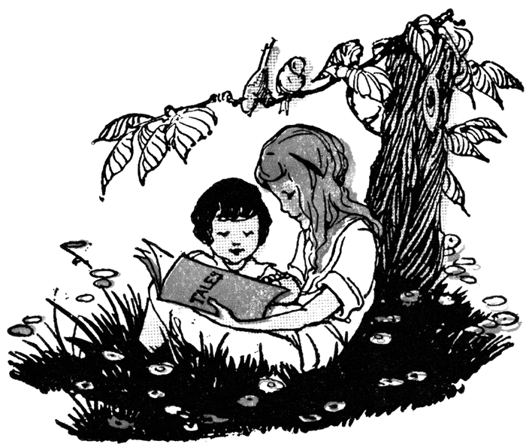
Reading: its meaning today
“Let books be your dining table, And you shall be full of delights Let them be your mattress And you shall sleep restful nights.” ~Author Unknown
Ksenia Lysikova
Year 9

Slide 2
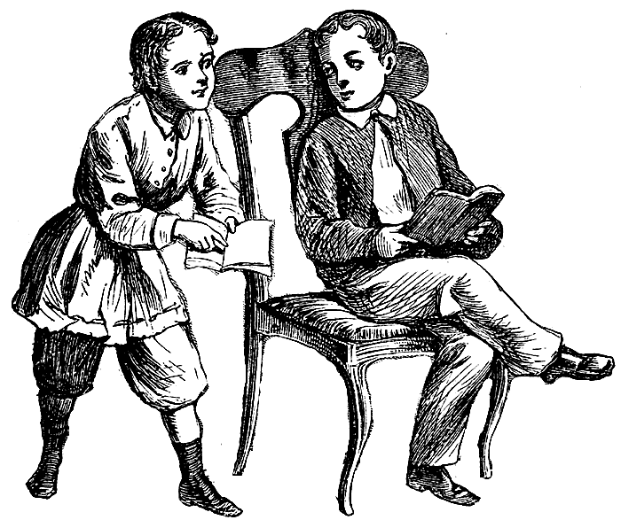
Why is reading important?
1. Reading is an active mental process that improves your concentration and focus:
Reading helps your brain work better which can help in our other subjects like maths and science where you need to concentrate fully on the task you are completing.
Picking up and reading a book means that enter a totally different mythical world where everything is possible. Sometimes it’s very pleasant to escape from reality and become someone else.

Slide 3
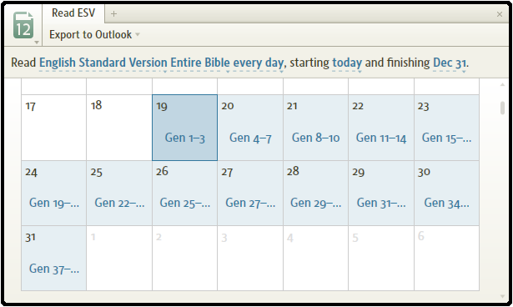
Why is reading important?
2. Improves your discipline and memory:
Sometimes we feel like reading but think that we have no spare time at all. To solve this problem we should make a special schedule and this will
Also improve our discipline in other subjects.
Reading helps to stretch your memory muscles and requires you to remember details, facts and figures, plot lines, themes and characters.

Slide 4
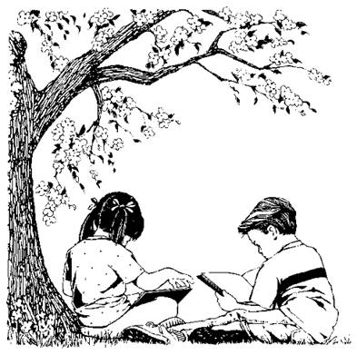
Why is reading important?
3. Builds self-esteem and improves creativity:
When you read books you gain knowledge and when you consider yourself clever, you are confident. Therefore we can see that reading builds self-esteem.
Reading about the diversity of life and exposing yourself to new ideas and more information helps to develop the creative side of the brain and filters innovation into your thinking process.

Slide 5
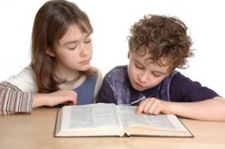
Why is reading important?
4. Reading improves your vocabulary and reduces boredom:
When we feel bored and feel like the time is moving very slowly, we can pick up a book and start reading. The advantage of the books is that we can read them anywhere and wherever we like. No internet connection is needed to read a book.
While reading we meet a lot of new complicated words. By seeing these words used in a certain way, we find out the meaning and our vocabulary becomes bigger.

Slide 6
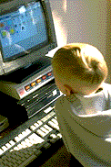
Why is reading less popular nowadays?
Nowadays reading is considered to be something only geeks and nerds do. In the modern world computers, TVs and game consoles dominate the lives of young people.
Also another reason for people reading less is the lack of time. We study, work and have more activities than before.
Books are quite expensive nowadays and not everyone can afford them. Of course, you can borrow some from the library but not everyone has access to one.

Slide 7
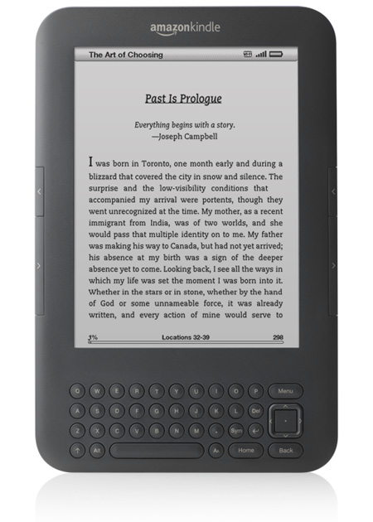
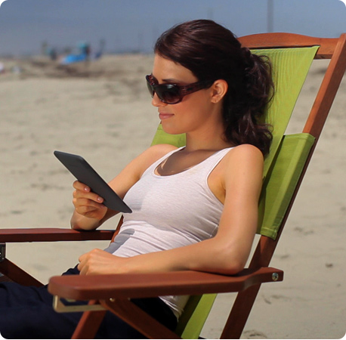
The new era for reading
Electronic reading devices have started appearing on the market and have proved to be very popular. These small e-books can hold up to 3000 books. You can download books in less than 60 seconds using Wi-Fi.
The special display is very good for the eyes, you can even read in bright sunlight and the battery life is exceptional.
I love my sweet little Kindle :D

Slide 8
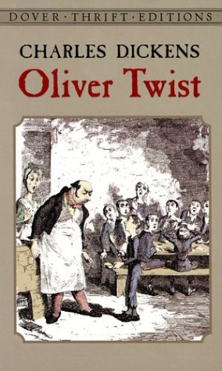
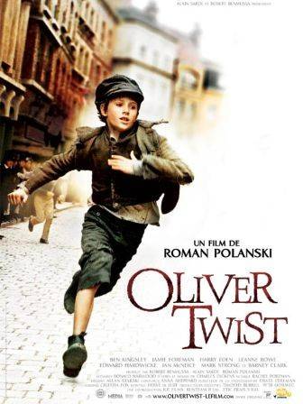
Reading VS Television
Today many books are made as films and people prefer to spend 2 hours watching a movie than a whole evening with a book. However reading a book is much healthier and pleasurable because you can imagine what the characters look like, where the events are happening, however in movies everything is already done.
VS

Slide 9
Reading and literacy statistics
Out-of-school reading habits of students has shown that even 15 minutes a day of independent reading can expose students to more than a million words of text in a year.
The average student learns about 3,000 words per year in the early school years (8 words per day).
Five to six year olds have a vocabulary of 2,500-5,000 words.

Slide 10
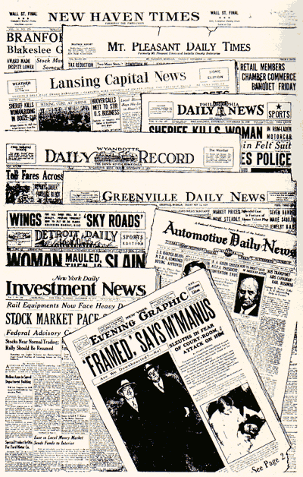
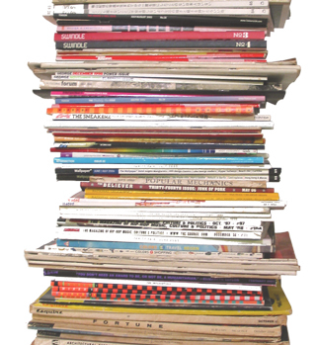
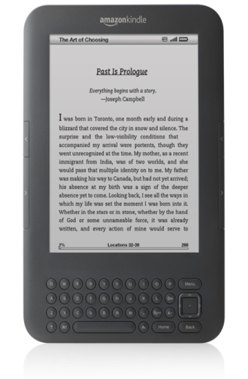
Ways to read
Newspapers
Magazines
Books
E-books
Audio books
Online

Slide 11
Conclusion
For my conclusion I would like to say that reading is very important in the lives of people because it develops creativity and memory, helps us in many other subject. There are different ways of reading but it is definite that we must read!

